Slide 1
STRATEGIC PLAN: HEALTh CITY CAYMAN ISLANDS
Murphy, Valente, Ward, Williams
(Group Two)

Slide 2
Introduction to The Strategic Plan
A thorough evaluation of Health City Cayman Islands was performed to identify current strengths, weaknesses, opportunities, and threats
Goals were developed to overcome our weaknesses, swart our threats, and further our strengths and opportunities
Primary Focuses (3)
The Cayman Islands, Our Community
Medical Tourism
Staffing and Supply Chain

Slide 3
Mission Statement
Health City Cayman Islands (HCCI ) brings quality, efficient, affordable healthcare to the Cayman Islands and the Caribbean. With cost-effective procedures at our disposal, we can provide that missing link in Caribbean healthcare, making such mechanisms as cardiac procedures accessible to the masses in the Cayman Islands and the Caribbean. We are here to serve the islands, ensuring generations to come will have all the accessibility to healthcare they need for a prosperous life.

Slide 4
Vision and Values Statements
Vision
The Vision of Health City Cayman Islands is to become the trusted and preferred healthcare organization of the Cayman Islands by:
Providing personalized, compassionate, high-quality, and affordable care to those from near (our locals) and far (Medical tourists)
Ensuring the availability of exceptional healthcare services is accessible to all.
Educating and training healthcare professionals through the development of nursing and medical programs, in combination with the most innovative technology and techniques, to ensure continued excellence and growth of services provided at HCCI
Values
Health City Cayman Islands values an experience like no other by providing the finest treatment possible through integrated clinical practice, education, and research by:
Putting the patient and their care first, offering exemplary client satisfaction.
Serving others with compassion and empathy while maintaining absolute integrity at all times.
Collaboration for success in a team adds value to the society in which we live.

Slide 5
Organizational History
Health City Cayman Islands was born from the vision of Dr. Devi Shetty and his company, Narayana Health.
NH: one of the world’s most cost-efficient healthcare service providers, but does not sacrifice quality.
2014: NH expanded to Grand Cayman, part of the United Kingdom’s Cayman Islands territory: Health City Cayman Islands
Arose from partnership between Narayana Health and Ascension Health (US nonprofit and faith based health system)
April 2015, HCCI earned accreditation by the Joint Commission International

Slide 6
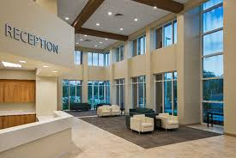
Organizational History (Cont.)
101-bed tertiary care hospital within 100,000 square feet.
Construction incorporated future cost savings things such as insulated concrete, on-site oxygen manufacturing, use of solar power, and maximizing natural light.
Cost per bed: $420,000 versus $1 million in US. Time to build: 12 months
Local factors affecting the implementation and success of HCCI
Enthusiasm of local business leaders
Well-developed tourism industry
Geographic proximity to multiple new markets
Higher operational costs than India
Supply chain logistics

Slide 7
Core Strategies: Provide Desirable / Low Cost Procedures
Current Surgical Services
Opportunities for growth
Bariatric Surgery
Cardiac Surgery
Thoracic Surgery
Orthopedic Surgery
Neurosurgery/Spinal Surgery
Colorectal Surgery
Gynecologic Surgery
Gastroenterology
Over 60% of medical tourism attributable to plastic surgery
Redistribute the profits to cover other care

Slide 8
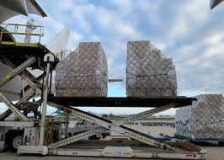
Core Strategies: Utilize Lower Cost Suppliers and Manufacturers
Sources pharmaceutical drugs and other medical supplies from India
Greatly reduced prices versus US costs
Allows for sustained organizational stability
Risk of decrease in availability if sourced internationally

Slide 9
Core Strategies: Globalizing Payment Systems
Offers greater flexibility
Improves the Patient Experience
Grows the patient base
Risk: Online payment security issues

Slide 10
Core Strategies: Focus On External Stakeholders
Focus on external stakeholders & factors that drive medical tourism
Large US Employers frequently self-insure medical claims for efficiency and cost savings.
HCCI offers lower priced health care costs
HCCI offers bundled pricing
The employer will know the entire cost of the procedure and hospital stay
Attracting large employers provides a large patient base to support economies of scale
Risk: Potential perception: Low cost equals low quality

Slide 11
Core strategies: Using Technology and innovation
Using Technology and innovation to expand access and care
EMR provides immediate access of patient records to referring providers
Advanced medical technology treats a wide range of clinical conditions
Personal concierge

Slide 12
Goals and Objectives
(Three to Five Years)

Slide 13
Goals and Objectives
Goal One: Improve the health of the Cayman Islands, Our Community
Eliminate health disparities
Educational programs to address health equity in the community
Develop educational programs for providers
Goal Two: Satisfactory staffing of Health City Cayman Islands
Local Job Fairs
Strengthen recruiting efforts and partnerships
Development of a tuition reimbursement program

Slide 14
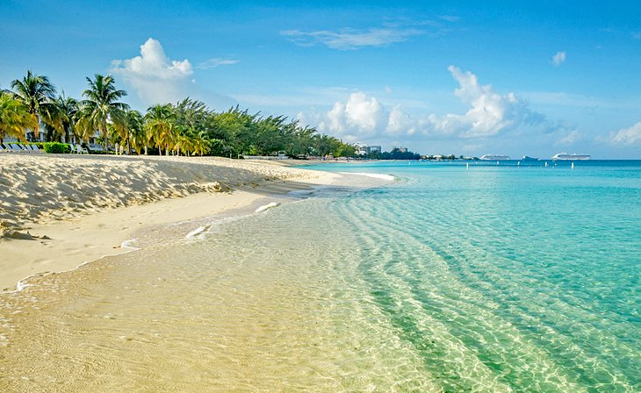
Goals and Objectives (Cont.)
Goal Three: Ensure HCCI is offering the most needed, as well as desired services
Identify the current needs of the local community and medical tourists
Continuous evaluation of local and tourist markets
Goal Four: Development of a personal concierge service to improve the medical vacation experience
Identify and partner with most popular attractions
Develop tourism/vacation packages to enhance experience

Slide 15
Goals and Objectives (Cont.)
Goal Five: HCCI will expand efforts to grow its bundled pricing market share
Review data of self-insured employers
Develop a marketing campaign address the unique health care needs of identified employers
Goal Six: Support/Develop strategies for globalization of payment methods
New Technologies and Mobile Payments
Incentives for use (i.e., buy now and pay later method)

Slide 16
Goals and Objectives (Cont.)
Goal Seven: Efficient supply chain management
Address and adapt to workforce shortage
Goal Eight: Increasing revenue to accommodate for future expected expenses
Determine future costs when duty-exemption expires
Goal Nine: Update Infrastructure
Address all infrastructure issues
Increase dwelling size to accommodate increase in population

Slide 17
Thank You For Your Attention
Health City Cayman Islands

Slide 18
References
Khana, T., & Gupta , B. (2016, March 16). Health City Cayman Islands. Harvard Business Publishing Education. Retrieved August 23, 2022, from https://hbsp.harvard.edu/download?url=%2Fcourses%2F964835%2Fitems%2F714510-PDF-ENG%2Fcontent&metadata=e30%3D
Photo: https://www.healthcitycaymanislands.com/about/health-city/
Photo: https://www.facebook.com/HealthCityCaymanIslands/
https://www.healthcitycaymanislands.com/
Photo: https://www.planetware.com/pictures/cayman-islands-cay.htm
Photo: https://blog.envirosight.com/sewer-school-what-is-sewer-slope
Photo: https://www.architecturaldigest.com/reviews/home-improvement/types-of-solar-panels

